Slide 1
Testing

Slide 2
Lesson Objectives
Discuss the importance of a complete test suite
Define the differences between unit, integration, and end-to-end testing
Create unit tests to achieve a specified code coverage level
Utilize fixtures and mocks to implement unit tests

Slide 3
Why Test?
Why is testing important?
Notes:
Ensure we don’t break things, ensure new feature works, ensures any edge work (what the customer might try)

Slide 4
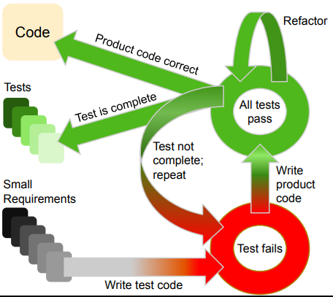
Test Driven Development
Different mindset of software development
Requirements → tests → code
Typically done in red-green-refactor phases
Write a failing test
Write code until the test passes
Refactor the code to cleanup
Notes:
Test driven development world, you write test cases first.
Requirements to fulfill, write test case to ensure requirements are met, then write code until all test pass, then shift the code

Slide 5
Testing Types
Functional
Unit tests
Integration tests
End-to-end tests
Acceptance
Non-functional
Security
Performance
Usability
Compatibility
Notes:
Functional “Does the code do what we think it will do”
Unit test – Test one unit (smallest entity of something), usually at function level
Integration test – take a few units and seem if the code works together
End-to-end – see if the whole workflow works properly
Acceptance – put a user Infront of the process to confirm if this meet the requirements

Slide 6
Unit Tests

Slide 7

Unit Testing
Is your house stable if the lumber is rotted?
Smallest piece of testable code : unit
Benefits
Helps ensure correctness
Catch problems early
Fast

Slide 8
Unit Testing / Reqts. Framework
Given – When – Then
Given: The initial conditions / prerequisites
When: The action or event to be verified
Then: The outcomes of the action or event
Useful for formulating unit tests based on requirements
Used to communicate with non-technical stakeholders
Tests should be complete, independent, reproducible, and small!!
Notes:
Complete: You have everything needed to complete the test
Independent: Don’t need anything else to run the test
Reproducible: Should always get a pass or fail from the test

Slide 9
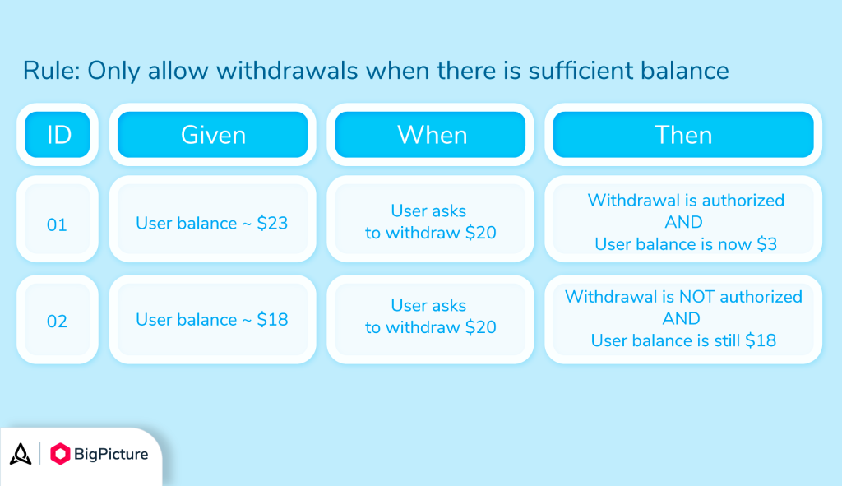
Notes:
We don’t only test successes, we must also test failures (as seen above)

Slide 10
Testing in Python
def add(a, b):
return a + b
def test_add():
assert add(1, 2) == 3
assert add(0, 5) == 5
def test_add_negative():
assert add(-5, -7) == -12
assert add(-5, 5) == 0
Pytest / unittest / doctest
Each has their own pros/cons
Assert statement
Notes:
How would you write “given, when, then” for the code on the right?
** We write code to validate our code **
We will use the Pytest feature/function
You can add a message to your assert statement (assert false, “Your code failed, you should stop coding.”
Assert statements only show true and false.
If the assert statements is true, it will continue to run the code.

Slide 11
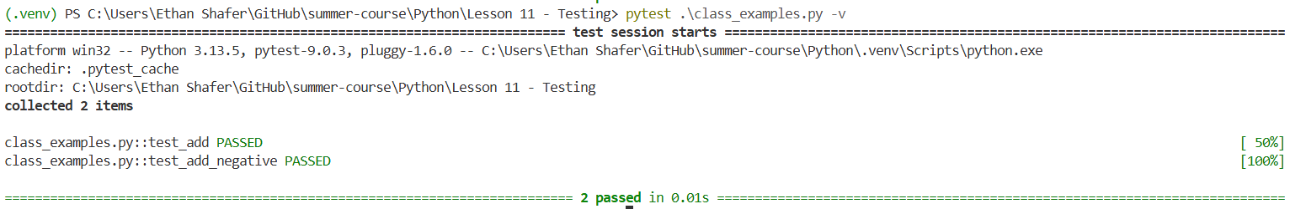
PyTest
def add(a, b):
return a + b
def test_add():
assert add(1, 2) == 3
assert add(0, 5) == 5
def test_add_negative():
assert add(-5, -7) == -12
assert add(-5, 5) == 0
A separate package / command
Generally auto-discovers tests
Can also give specific files
pip install pytest
pip install pytest-cov

Slide 12
Pytest Example
Temperature conversion
Scenario 1
Given a temperature of 0C
When I convert to F
Then I should get 32F
Scenario 2
Given a temperature of 100C
When I convert to F
Then I should get 212F
Scenario 3
Given a temperature of -40C
When I convert to F
Then I should get -40F
Scenario 4
Given a temperature of -300C
When I convert to F
Then I should get an error!

Slide 13
Hands-On #1

Slide 14
Other Testing Ideas

Slide 15
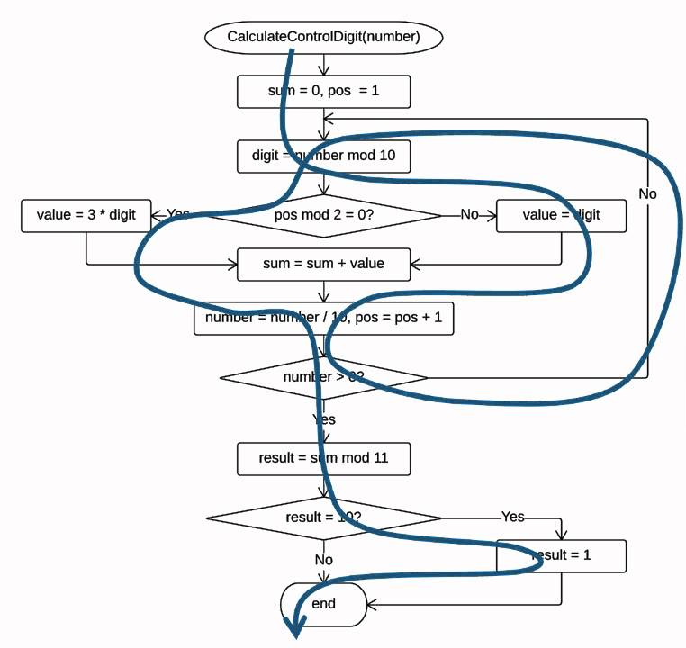
Completeness
Control flow statements create branches
Are we covering every path?
How much coverage is appropriate?
Generally ~80%, domain dependent

Slide 16
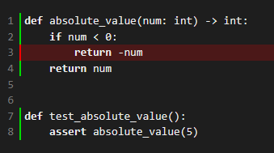
Small Example
def absolute_value(num: int) -> int:
if num < 0:
return -num
return num
def test_absolute_value():
assert absolute_value(5)

Slide 17
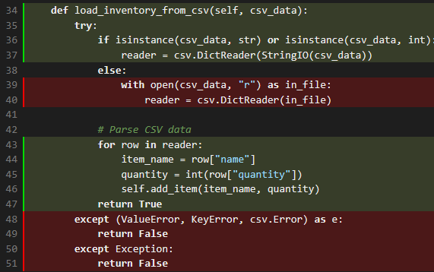
Larger Example
Inventory class
pytest --cov=inventory --cov-report=term-missing --cov-report=html
What could be hiding in this coverage?
Notes:
Line 36 of inventory.py might be "covered" but you need to be careful about the 'or' statement

Slide 18
Another Example
def sin(num: int) -> int:
return 0
def test_sin():
assert sin(0) == 0
Tests should be complete, independent, reproducible, and small!!

Slide 19
DRY
Case 1:
Consistent config / setup
Consistent parameters
Case 2:
Input data generally stays the same
Multiple functions might need the same inputs
Have to write the same input data for each test?
Case 3:
Specific objects might take a while to instantiate
We want our tests to be fast
Preload those objects

Slide 20
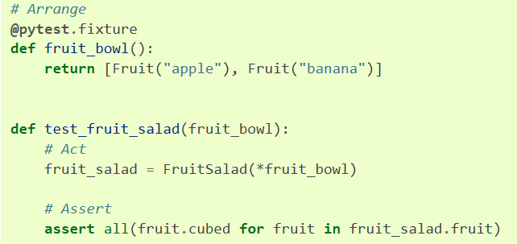
Fixtures
Notes:
https://docs.pytest.org/en/7.1.x/how-to/fixtures.html

Slide 21
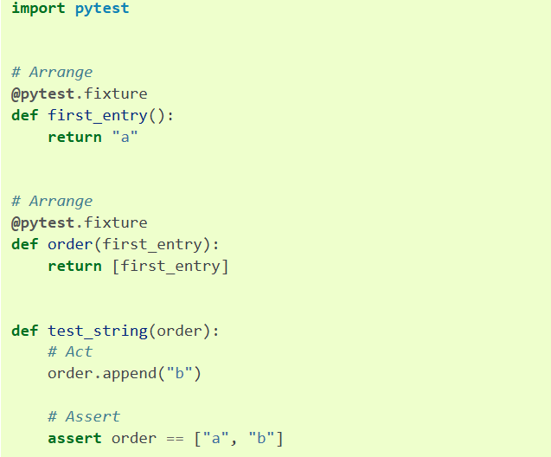
Fixtures
Notes:
Fixtures are cached but side effects are not kept

Slide 22
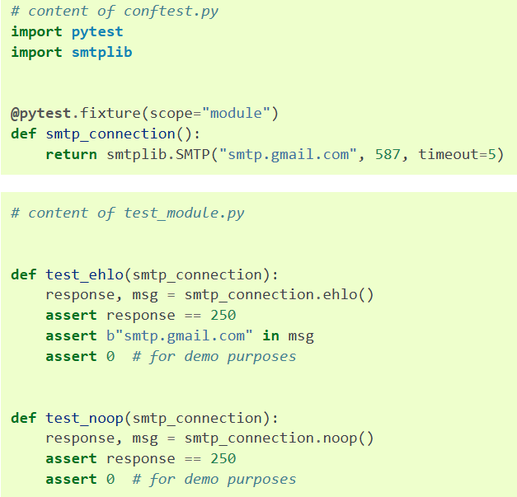
Fixtures
Notes:
This fixture is shared and not created multiple times

Slide 23
Mocking External References
import requests
def get_user_name(user_id):
"""Fetch a user's name from an API."""
response = requests.get(f"https://api.example.com/users/{user_id}")
if response.status_code == 200:
return response.json().get("name")
return None

Slide 24
Mocking External References
import pytest
from http import get_user_name
def test_get_user_name_success(mocker):
"""Test get_user_name with a mocked requests.get"""
# Create a mock response object
mock_response = mocker.Mock()
mock_response.status_code = 200
mock_response.json.return_value = {"name": "Alice"}
# Patch requests.get to return our mock response
mocker.patch("app.requests.get", return_value=mock_response)
# Call the function under test
result = get_user_name(123)
# Assertions
assert result == "Alice"
app_requests_get = mocker.patch("app.requests.get")
app_requests_get.assert_called_once_with("https://api.example.com/users/123")

Slide 25
Hands-On #2

Slide 26
Questions

